Slide 1

Analyze NYSE Data
Ayush Gupta

Slide 2
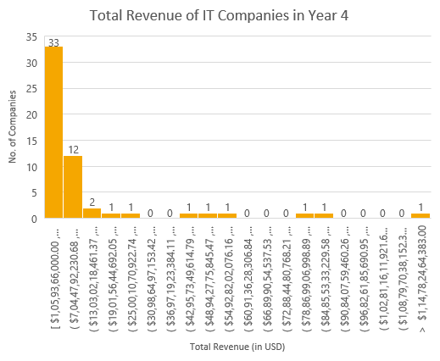
What is the Total Revenue for IT Sector Companies in Year 4?
Here is a histogram for Total Revenue of IT Companies in Year 4.
As we can see the histogram is right or positively skewed.
The Mean for total revenue in Year 4 is $16,035,034,620, more than the three times value of the median $5,568,700,000.00.
This histogram shows us that most of these companies will earn between $1 Billion to $7 Billion in Year 4, i.e., 33 companies.
We also found the Standard Deviation for total revenue to be $32,915,809,921.49 which is rather high, and thus we can conclude that high standard deviation means that values are spread out, with the more revenue generating companies affecting the standard deviation.
Finally, about skewness, we can say that the presence of 3 IT Companies with total revenue more than $78 Billion in Year 4 can explain it all.

